Slide 1

Digitizing DVD/Blu-Ray Collection

Slide 2
Software
MakeMKV (https://www.makemkv.com)
Handbrake (https://handbrake.fr)

Slide 3
What is MakeMKV
Used to create an uncompressed video copy of a DVD or Blu-ray disc
Decrypts the DVD or Blu-ray disc
Saves the video file in an .mkv format

Slide 4
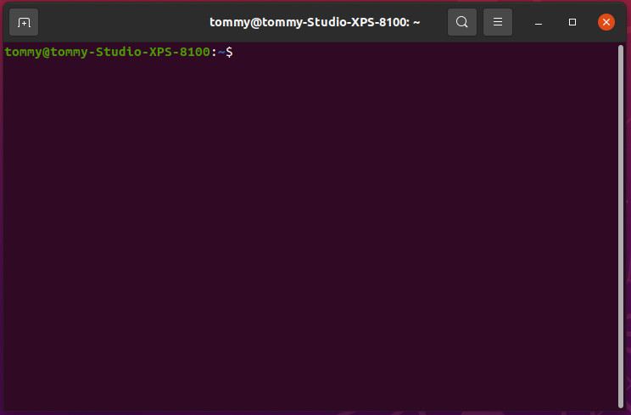
Install MakeMKV
sudo add-apt-repository ppa:heyarje/makemkv-beta
sudo apt update
sudo apt install makemkv-bin makemkv-oss

Slide 5

Configure MakeMKV
Start the MakeMKV program
Click on View, Preferences or the Wrench icon
On the Video tab, Click on Custom to set a default output folder (where you want to save the video files)
Change the Minimum title length from 120 to 600
On the General tab, Click on Expert mode
On the IO tab, click on Ask for single drive mode (ONLY if you have more than one DVD/Blu-ray drive)
On the Language tab, change Interface to English and change Preferred Language to English
Click OK to save the new configuration

Slide 6
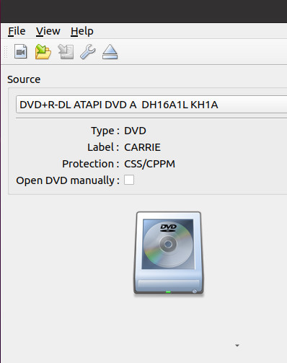
Use MakeMKV
Insert DVD/Blu-ray disc in drive
Click on the Drive icon to start the process of identifying the disc

Slide 7
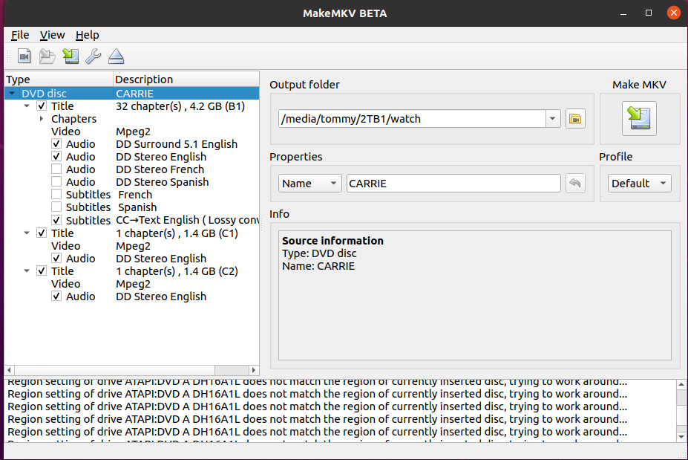
Use MakeMKV
Make any changes you desire to the Title options
Click on the MakeMKV icon to start the digitizing process (ripping the disc)

Slide 8
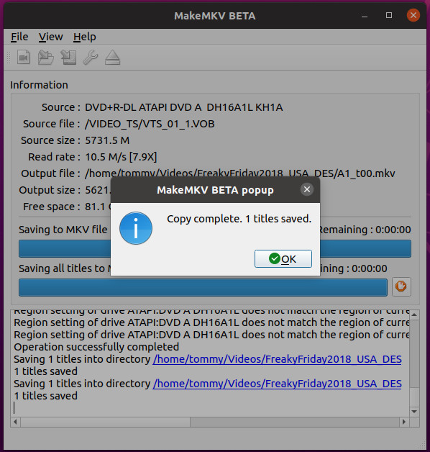
Use MakeMKV
When the disc is done you will get the below screen. Click on OK. You can now start ripping another disc.
Click File, Extract disc

Slide 9
Pro/Con MakeMKV
PRO | CON
Free for DVD use | Must obtain beta key every 30 - 60 days
All features free during beta | $60 plus tax for lifetime registration
Uncompressed video copy | Does not compress video file
Multiple simultaneous rips | Requires lots of hard drive space

Slide 10
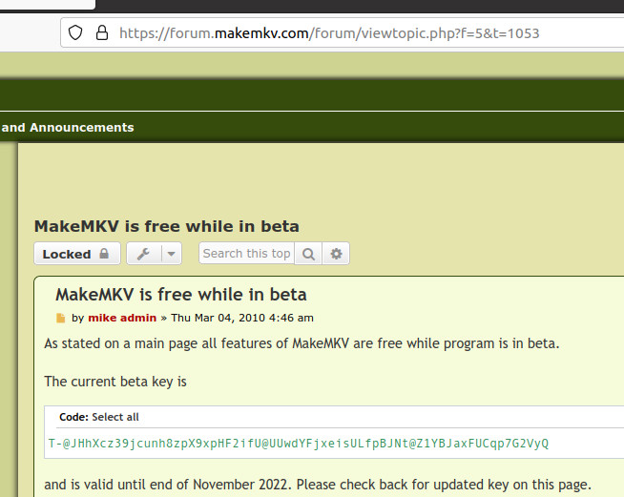
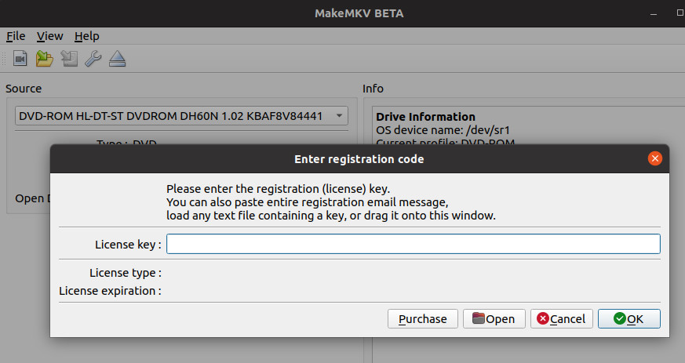
MakeMKV Beta Key

Slide 11
What is Handbrake
Used to create a compressed video copy of a DVD or Blu-ray disc
Does not natively decrypt commercial DVD or Blu-ray discs (MUST install ubuntu-restricted-extras)
Make sure (multiverse) has a check mark located in Software & Updates (Ubuntu Software tab)
Saves the video file in an .mp4 or .mkv format

Slide 12
Install Handbrake
PPA repository (Ubuntu 20.04 and older)
sudo add-apt-repository ppa:stebbins/handbrake-releases
sudo apt update
sudo apt install handbrake-gtk

Slide 13
Install Handbrake
PPA repository (Ubuntu 22.04 and older)
sudo add-apt-repository ppa:savoury1/handbrake -y
sudo add-apt-repository ppa:savoury1/ffmpeg4 -y
sudo apt update && sudo apt upgrade -y
reboot
sudo apt install handbrake -y

Slide 14
Install Handbrake
Flatpak on Flathub
sudo apt install flatpak -y
reboot
sudo flatpak remote-add –if-not-exists flathub https://flathub.org/repo/flathub.flatpakrepo
flatpak install flathub fr.handbrake.ghb -y
I DO NOT recommend this option as you must then provide permissions to use all of the disc drives you have installed (this may or may not work properly)

Slide 15

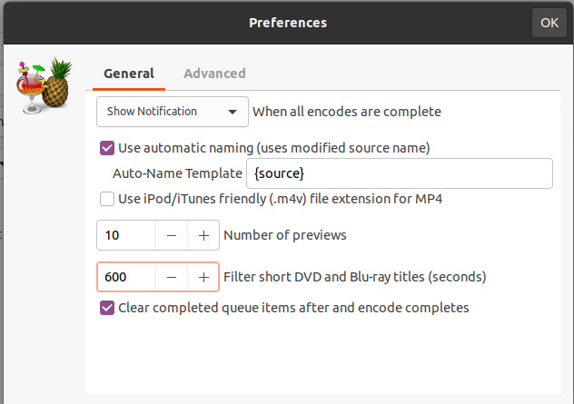
Configure Handbrake
Start the Handbrake program
Click on File, Preferences
On the General tab, change the “Filter short DVD and Blu-ray titles (seconds)” to 600
Click on “clear completed queue items after and encode completes”
Click OK to save the new configuration
Close Handbrake and restart Handbrake for the new configuration to take effect

Slide 16
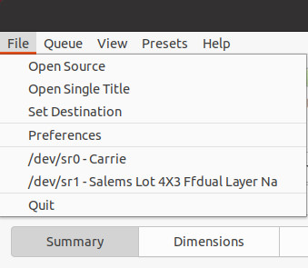
Use Handbrake
Insert DVD/Blu-ray disc in drive
Click on File and the /dev/ device that contains the DVD/Blu-ray you wish to rip. This will start the process of identifying the disc.

Slide 17
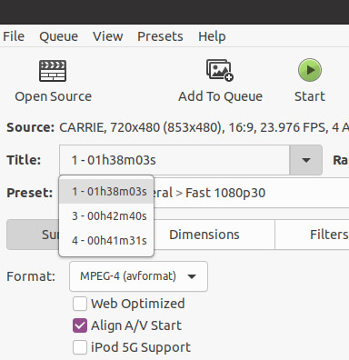
Use Handbrake
After the disc has been identified, check the Title: to choose the track that contains the movie/episode you wish to rip
If you want to use the default Preset:, click the Start button to rip (transcode/compress) the disc image

Slide 18
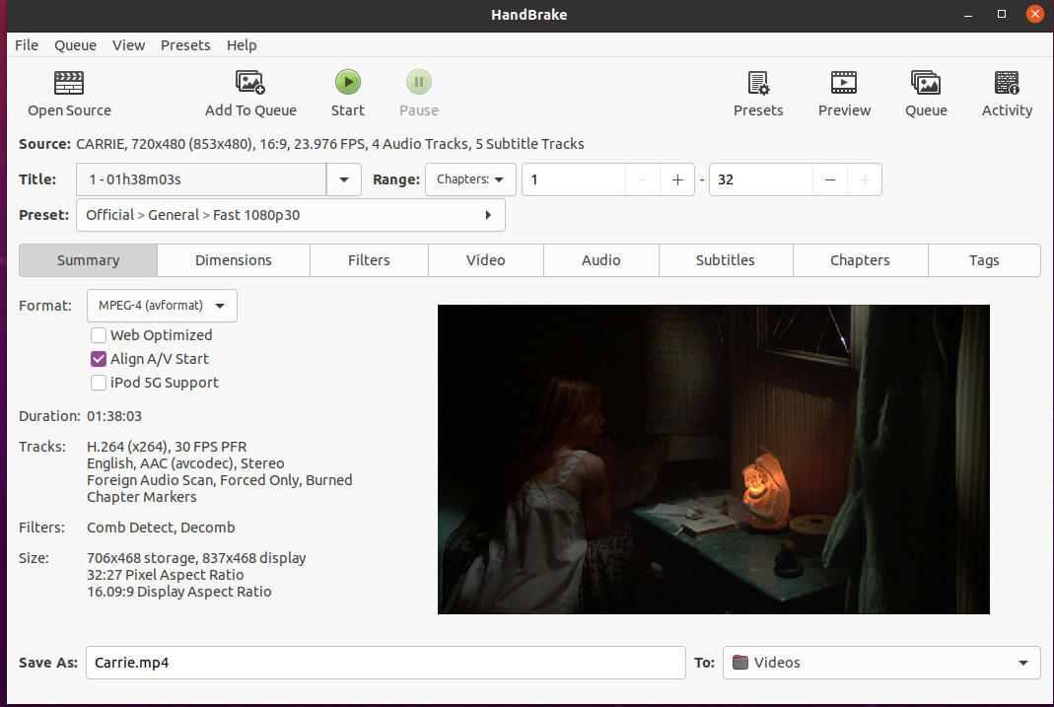
Handbrake Presets
You can change any of the preset function as you desire
Go to:
https://handbrake.fr/docs/en/1.3.0/workflow/adjust-quality.html

Slide 19
Pro/Con Handbrake
PRO | CON
Free
Compressed video copy | Does not create an uncompressed video file
Requires less hard drive space | CPU can overheat
Can compress multiple video files sequentially

Slide 20
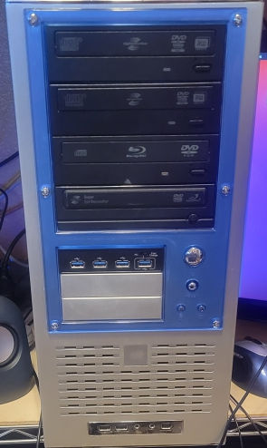
My Ripping Machine
HP 6540f motherboard AMD Phenom II x 4 965 16GB DDR3 1333 MHz Nvidia GeForce GT680 Sandisk 120 GB SSD (boot) Western Digital 3TB HDD (home-data) 3 x DVD+R Writers 1 Blu-Ray Reader Cooler Master 650 Gold Power Supply 1GB Ethernet Dell 24” Flat Panel Monitor Ubuntu 20.04.05 LTS

Slide 21

Cochise Linux User Group

